Slide 1

ASHRAE PROJECT COMMITTEE TRAINING VOTING AND BALLOTING
Updated: April 2025

Slide 2
INTENDED AUDIENCE
The intended audience for this training presentation is members and potential members of ASHRAE Standard and Guideline Project Committees. It is not intended to go into detail on topics/tasks that are only of relevance to Project Committee chairs (such as creating online ballots, balancing committee membership, etc.). These topics are covered in depth in other training materials. Please refer to the ASHRAE PCs Toolkit for additional information.

Slide 3
PROCEDURAL REFERENCES
Procedures for ASHRAE Standards Actions (PASA)
PCs Guide to PASA
Instructions for Balloting for Chairs
PC Members Instructions for Online Ballots
ASHRAE Simplified Rules of Order – Quick Reference
Refer to the PCs Toolkit webpage for the most current versions.

Slide 4
TERMS/ACRONYMS/DEFINITIONS
TERM | DEFINITION
Advisory Public Review (APR) | A draft submitted for public review that contains unusual, potentially controversial, or new elements that the project committee believes would benefit from increased public scrutiny prior to finalizing the draft for publication public review.
Project Committee (PC) | A project committee (of volunteers) that serves as the consensus body for a standard, guideline, or portion thereof (i.e., addendum)
Project Committee Voting Member (PCVM) | A project committee member who is eligible to vote on PC motions. PCVMs are also eligible to vote on subcommittee motions to which the PCVM is appointed.
Publication Public Review (PPR) | A draft approved for public review that will proceed directly to publication if, as a consequence of the review, no substantive changes are made to the draft.
Standards Action vote | An action recommending or approving publication or publication public review of a new, revised, or reaffirmed standard, guideline, or addendum or withdrawal of a published standard, guideline, or addendum.
Unresolved objectors | All unresolved commenters and negative PC voters that provided a reason for their negative vote on a standards action vote since the last full public review.

Slide 5
TYPES OF PROJECT COMMITTEE MOTIONS
Standards Action | Non-Standards Action | Official Interpretation
Votes for: Publication Public Review (PPR) Publication with knowledge of unresolved objectors (unresolved PPR commenters/negative PC voters) | Votes for: Advisory Public Review (APR) Approval of Committee Work Plans Approval of Committee Meeting Minutes Straw votes on draft language Responses to Continuous Maintenance Proposals (CMPs) Responses to public review comments Other | Votes for Approval of Official Interpretations of Standards or Guidelines
Note: All official motions and voting results are to be recorded (in meeting minutes or OSR ballot report).

Slide 6



VOTING AT MEETINGS
In order to initiate a vote on a motion at a PC meeting, a quorum (50%+1) of PCVMs must be present. Voting on motions can also be initiated via the Balloting Portal in the ASHRAE Online Comment Database: (https://osr.ashrae.org)
For Standards Action motions, if there are any PCVMs who are not present for the vote, a continuation ballot MUST be circulated to allow them any opportunity to vote. Approval requires a simple majority (50%+1) of the voting membership voting in the affirmative.
Non-Standards Action motions do NOT require a continuation ballot. These motions may be initiated at a PC meeting and approved by a simple majority of the PCVMs present.

Slide 7
STANDARDS ACTIONS MOTIONS
Standards Actions motions require that ALL voting members be given an opportunity to vote, including those who are not in attendance a PC meeting at which a motion is initiated; this can be accomplished by a continuation ballot following the meeting.
If negative votes (with reason) are cast, the reasons for the negative vote(s) must be recirculated (via a recirculation ballot) to the voting members, and members given an opportunity to change their vote. A written response to negative voters on a letter ballot (typically drafted by the chair) may be included with the recirculation ballot. This response must advise the negative voter(s) of the disposition of their objection(s) and the reason(s) why.
Note that “Chair Not Voting” (CNV) is not an option for Standards Action motions. If a chair is not casting a vote in favor of or in opposition to a motion, the chair’s vote should be recorded as an abstention.

Slide 8
NON-STANDARDS ACTIONS MOTIONS
Non-Standards Actions motions are any motions which are not Standards Actions motions (approval of PPR/publication) or approval of an official interpretation of a standard or guideline.
Non-Standards Actions motions do not require that all voting members be given an opportunity to vote; for motions taken at official meetings of a committee, approval requires affirmative votes by a simple majority of voting members present (as long as quorum is met). The vote count is to be recorded in the meeting minutes; negative voters and abstainers should be recorded but a roll call vote is not necessary.
If a non-Standards Action vote is taken by OSR ballot, a simple majority of voting members is required for approval. Recirculation of reasons for negative votes and responses to negative votes from the PC are not required.

Slide 9
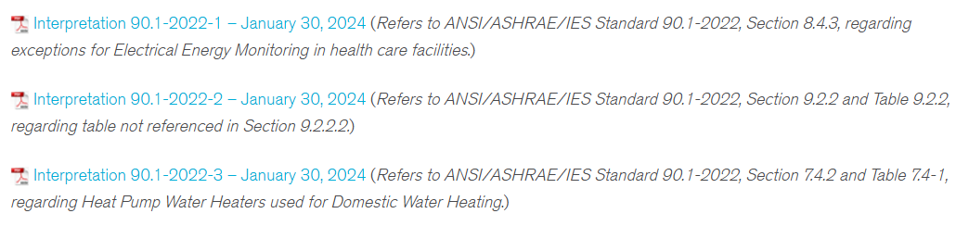
OFFICIAL INTERPRETATION APPROVALS
An official interpretation is a written explanation of the meaning of a specific provision of a standard or guideline, as determined by a cognizant PC, in response to a written request.
Approval for issuance or revision of an official interpretation requires affirmative votes from the majority of committee voting members.

Slide 10
SUBCOMMITTEE MOTIONS
Subcommittees may be responsible for tasks such as managing addenda, appendices, and comment responses related to the standard or guideline. In cases where an SSPC manages multiple documents, a subcommittee may be responsible for a complete standard or guideline.
Any subcommittee motions related to a standard, guideline, or addendum (publication public review, publication, responses to CMPs, responses to comments) must be submitted as recommendations to the parent project committee. The parent project committee must approve any actions recommended by the subcommittee.
Subcommittee motions are not considered Standards Actions, and do not require continuation ballots, recirculation ballots, or that negative votes be responded to.

Slide 11
ONLINE BALLOTING
Online balloting (via the ASHRAE OSR) can be used by project committees for both Standards Actions and non-Standards Actions votes. Note that only PC chairs (or assigned designees) are able to create ballots.
NOTE: Please add OSRAcknowledgement@ashrae.org to your safe senders list to ensure that you receive notices related to PC ballots.

Slide 12
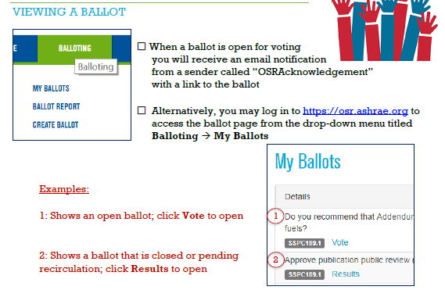
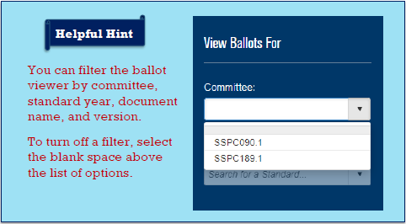
ACCESSING AND VIEWING BALLOTS
When a ballot opens for voting, ALL members on a project committee roster will receive a notification by email; however, only Project Committee Voting Members (PCVMs) will actually be able to cast a vote.

Slide 13
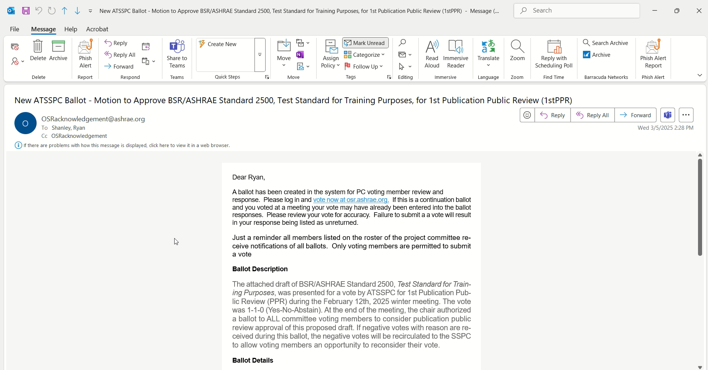
VOTING ON BALLOTS
Ballots can be directly accessed from the link in the notification email. Please note that this link is unique to each individual voting member and will not work if shared with others.

Slide 14
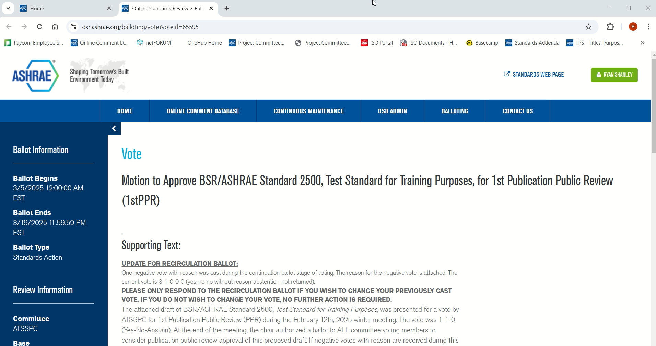
RECIRCULATION BALLOT
If negative votes with reason are cast on Standards Action motions, a recirculation ballot with be sent to the committee with the reason(s) for the negative vote(s) and response from the PC chair (if any).

Slide 15
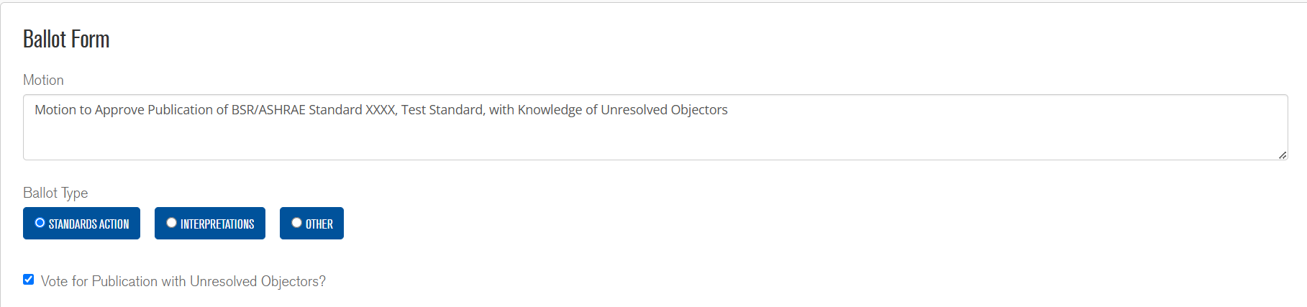
FINAL VOTE FOR PUBLICATION
Once the PC has consensus that no further changes to the draft document are needed, if unresolved commenters or negative voters (from PPR votes) remain, the PC must take a “Vote for Publication with Unresolved Objectors.” This is a Standards Action vote, and if conducted via OSR ballot, the relevant check box must be selected.

Slide 16
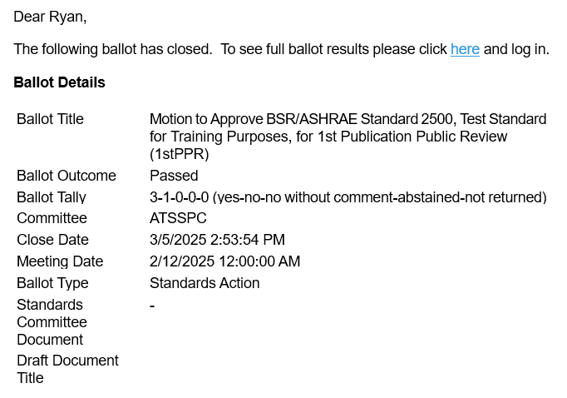
VIEWING BALLOT RESULTS
Once a ballot has closed and the results are finalized, an automatic notice will be sent to all PC members indicating the ballot outcome and vote tally.

Slide 17
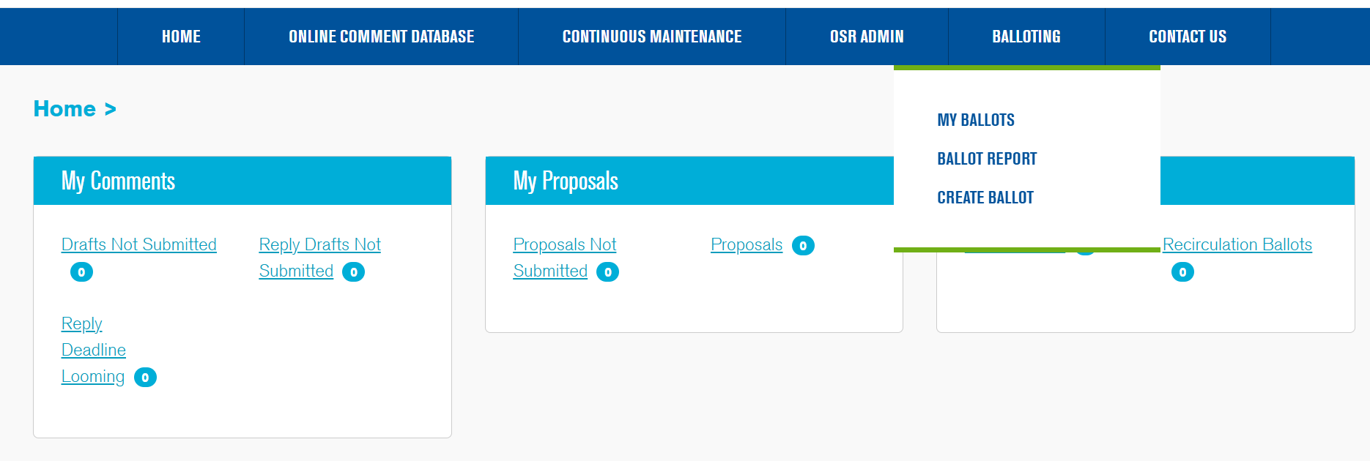
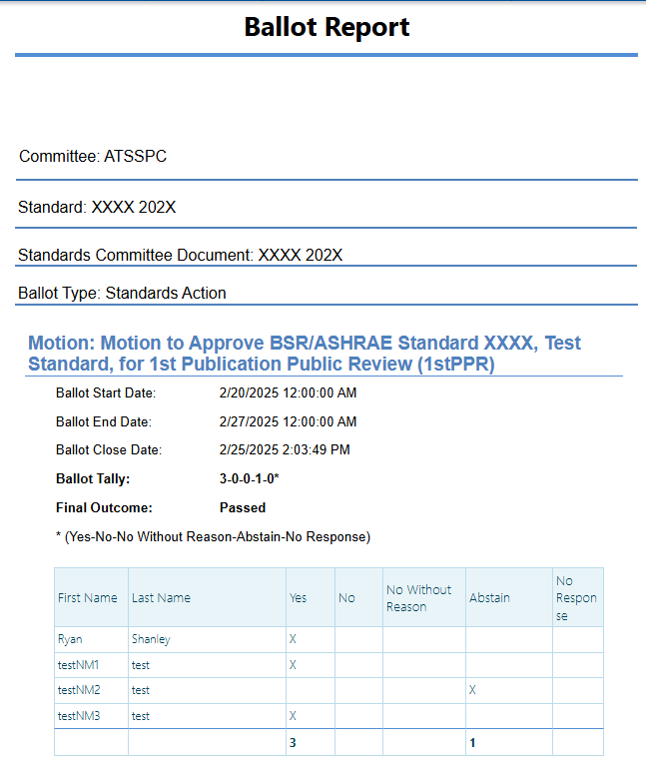
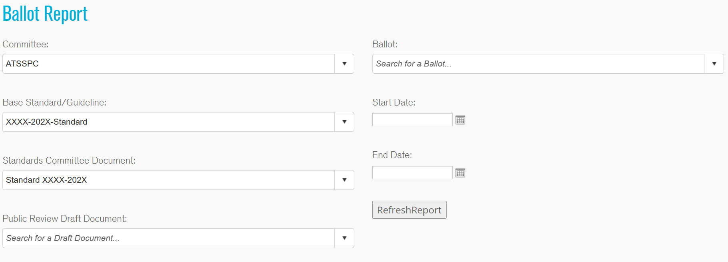
VIEWING BALLOT RESULTS (REPORT)
A detailed ballot report can be view/downloaded through the OSR.

Slide 18
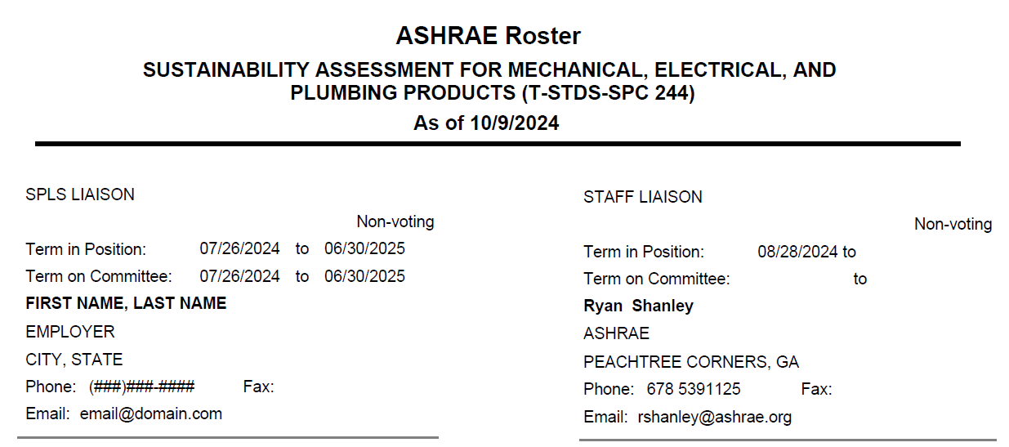
QUESTIONS/ASSISTANCE
Every ASHRAE project committee is assigned both an SPLS liaison and an ASHRAE staff liaison, either of whom is an invaluable resource for guiding/assisting the PC’s work.
The names of the committee’s assigned SPLS and staff liaisons can be found at the very end of the committee membership roster.

Slide 19
STANDARDS SECTION STAFF
Direct Phone Line: (678) 539-XXXX (Ext.)
Staff Member | Email Address | Ext.
Standards Committee Ryan Shanley, Senior Manager of Standards | rshanley@ashrae.org | 1125
Procedures, PPIS, Appeals Tanisha Meyers-Lisle, Asst. Manager of Standards - Administration | tmlisle@ashrae.org | 1111
SPLS, SRS Carl Jordan, Standards Administration Specialist | cjordan@ashrae.org | 1175
General Inquiries/Assistance Standards Section | standards.section@ashrae.org

